Slide 1
Web Development
CSE343
Lab 7

Slide 2
Backend Basics, REST, Async/Await

Slide 3
Agenda
The backend
REST
Let's design our own API
How to integrate frontend with backend
Async/Await

Slide 4
The backend
The backend is the code that is concerned with the logic of the application
As opposed to frontend which is concerned with displaying the application
So far, we have been learning frontend
Time to learn some backend!

Slide 5
The backend
So, what does the backend do?
Take Amazon as an example:
when you first open the page, the backend sends you the products catalog to be displayed
When you order an item, it starts processing your order: updating the stock, creating a delivery shipment, … etc
It is also responsible for processing the payment
So basically, the backend handles the logic of your application

Slide 6
The backend
For frontend, we used html, css, and js which are the native languages that run in the brower.
We also used a library like React to make our lives easer
For backend, you can use any programming language.

Slide 7
The backend
Here are some examples for some languages with some of theirbackend framwork:
Python: FastAPI, Flask, Django
Java: Spring Boot
Ruby: Ruby on Rails
Go: Gin
Javascript: Express, NestJS
There are many many more of these ...
Essentially, any language had some dudes that said: "I wanna do backend in this language" and built a framework for it
We will study some of these later

Slide 8
The backend
So, how do we approach such an important part of the webapp?
We have our logic running in any general purpose programming language
We expose the functionalities through an API
There are a couple of API architectures out there
We will focus on one of them since it's the most widely used
REST!

Slide 9
REST
For many applications, the role of the backend simply boils down to CRUD operations:
Create: Inserting data to some database like making an order on amazon (where an order is just a simple entry in the orders table)
Read: Reading the data from the database like getting the previously made orders
Update: Updating the data like changing the address for an order
Delete: Deleting the data like cancelling an order (where the cancellation is simply deleting the order row from the database)

Slide 10
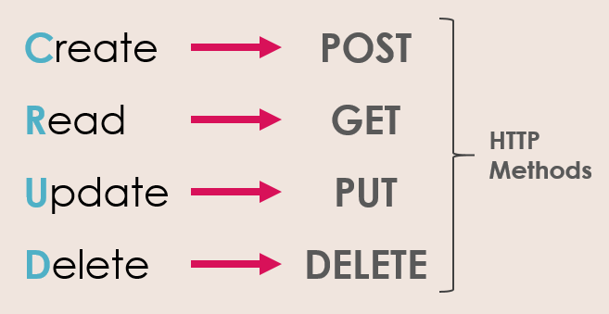
REST
Rest uses HTTP methods to achieve these operations:

Slide 11
REST
Now we know the methods, what's next?
We specify the name of the method, then the URL of the data we want to apply the method on.
For example:
GET /api/orders -> returns all the orders we made
GET /api/orders/ord1 -> returns the order with ID "ord1"
POST /api/orders -> creates a new order
PUT /api/orders/ord1 -> updates the order with ID "ord1"
DELETE /api/orders/ord1 -> deletes the order with ID "ord1"

Slide 12
REST
The data is typically returned in JSON format
We can add additional parameters to the data we send with 3 ways:
Path parameters: like "ord1", we are telling the api to return the data with this id
Query parameters: are added after a "?" at the end of the URL and are "&" separated. For example:
GET /api/orders?sortBy=date&order=asc
This is telling the API to sort the orders by their dates in ascending orders
Body: Sending a json body with the request for additional data. For example sending the date of the order in the body of the POST requests

Slide 13
REST
Okay that was a lot of information…
For now, know that there are 3 ways to pass arguments to your API call: query parameter, path parameters, and the body
Use path parameters for IDs to specify the item you are accessing
Use query parameters for small data like sorting and filtering
Use body for large data. Typically in JSON
BTW, GET requests cannot have a body/payload

Slide 14
REST
Let's try sending some requests to some APIs
To do that, we will use Postman
Open it
Let's play with this API

Slide 15
Let's design our own API
We want a very simple twitter like API where the user can:
Upload a post
Edit a post
Delete a post
Read all posts
Add a comment to a post
Read post comments

Slide 16
Let's design our own API
We will design it in using postman mock servers
Our mock server will return static data
Solution

Slide 17
How to integrate frontend to backend
Well, that was fun. Now, how can we make the frontend access our beautiful backend?
We have a very simple API in javascript called fetch
We simply give it the http method, the url and other parameters and it calls the API for us
fetch('https://.../posts', {method: "POST"})
There is one issue though...

Slide 18
How to integrate frontend to backend
These requests take time!
Time for the server to process the request
Time for the request and response travelling in the network
So, we cannot simply block everything waiting for the request to return
What we want is for the browser to start the request, go on with its business, and when the response arrives it should continue the function
To do that we use Async/Await

Slide 19
Async/Await
async: A keyword you add before a function declaration. It tells JavaScript, "This function will contain asynchronous operations."
await: A keyword you use inside an async function. It "pauses" the function execution until a Promise resolves, then gives you the result.

Slide 20
Async/Await
Let's see this in action
Fork this repo: https://github.com/mina58/lab-8-web
Clone it
Change the URL in api.js to your mock api
Implement the functions using await fetch and the API endpoints you created

